Slide 1

ANTH 3380: Evolutionary Medicine and Health
Chapter 2
Evolutionary theory

Slide 2
Natural Selection

Slide 3
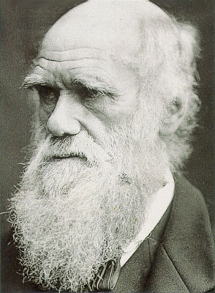
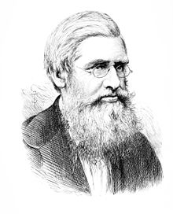
Evolution by Natural Selection
Foundational contribution by Charles Darwin and Alfred Russel Wallace
  Quite different upbringings
  But some similar influences (Malthus, Lyell, international travel, collecting creatures)

Slide 4
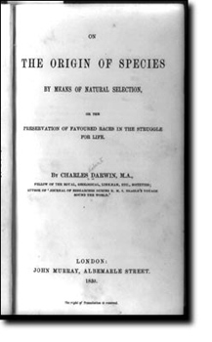
Great Moments in the History of the Universe: Publication of Darwin’s (1859) Origin of Species

Slide 5
Natural Selection
Consists of multiple necessary and sufficient conditions:
  Variation in a trait exists
  That variation is heritable
  That variation is linked to differential survival and reproductive success

Slide 6
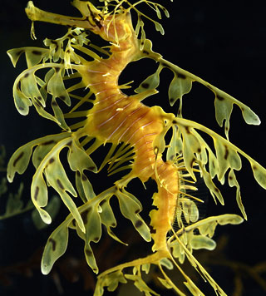
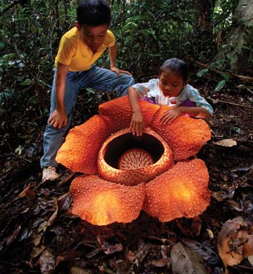
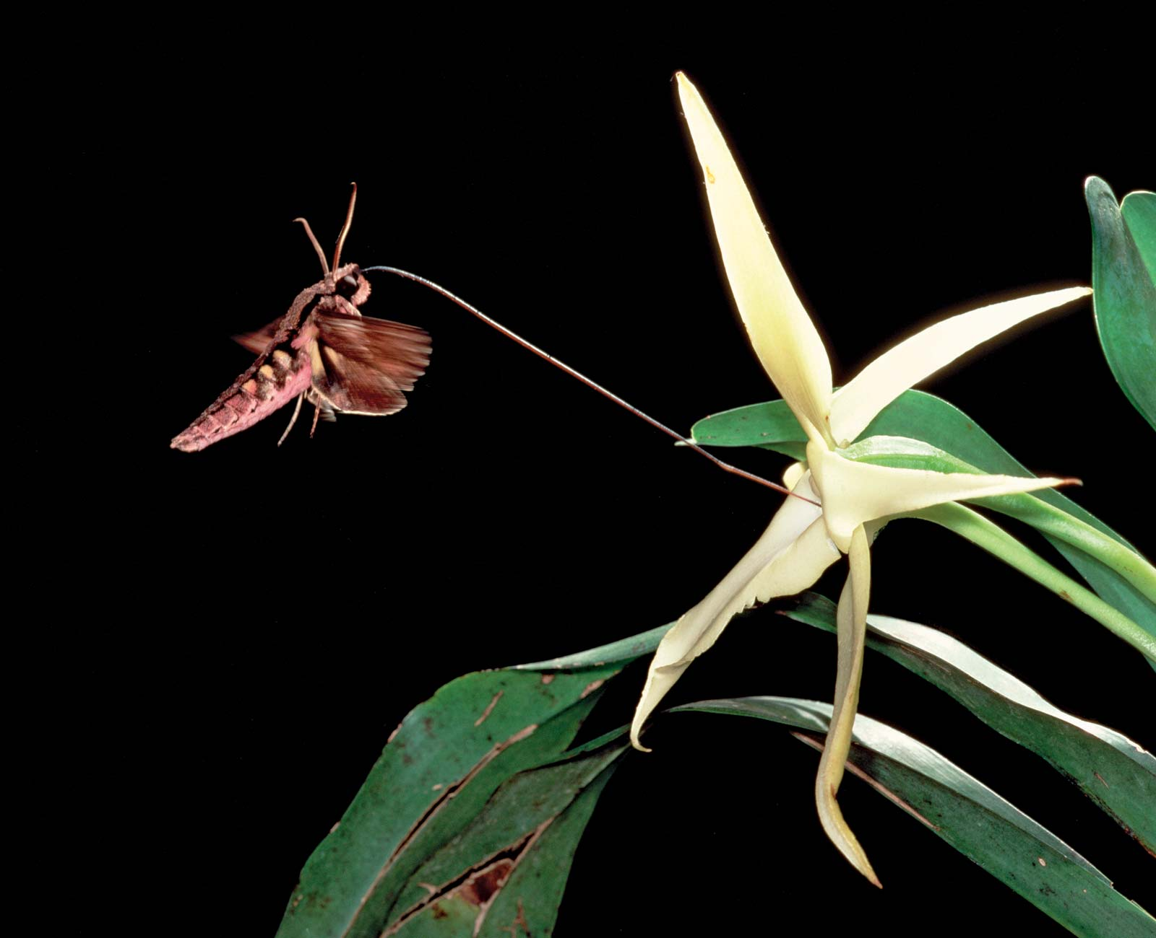
Natural Selection
The only natural process capable of giving rise to adaptations.
Examples of adaptations: Leafy sea dragon, Rafflesia flower, and Darwin’s hawk moth

Slide 7
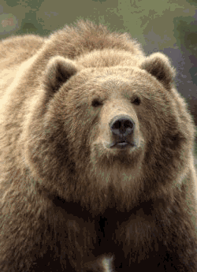
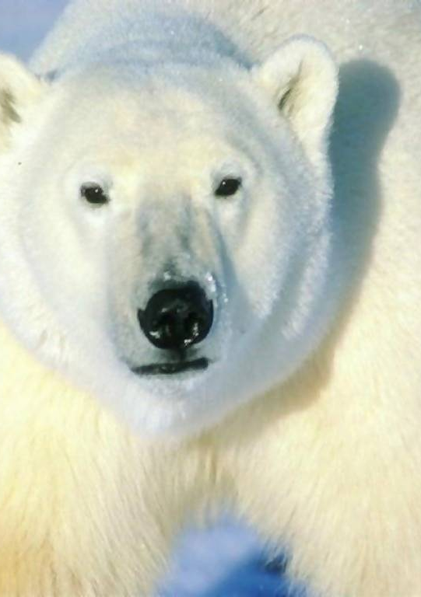
Natural Selection
Selection acts on phenotypes, in turn changing frequency of heritable units (such as genes).
Notes:
(observable behavioral, morphological or physiological traits),

Slide 8

Genotype and Phenotype
Every phenotype is the product of an interaction between genotype (genetic variant) and environment
G x E = P

Slide 9
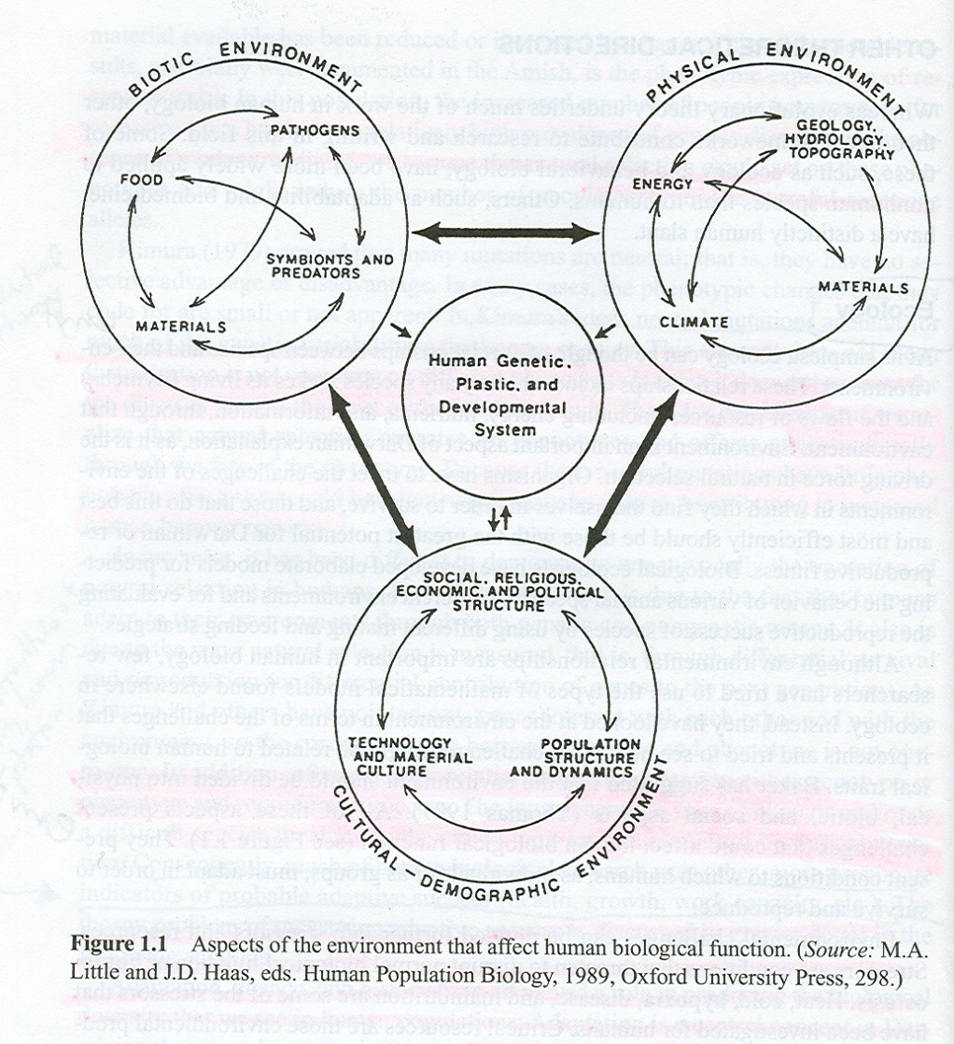
Environment
In this class, we mean the environment writ large:
  Solar radiation, temperature, nutrition, energy expenditure, predators, family members, social allies and competitors, sociopolitical structures at the local, national and international levels

Slide 10
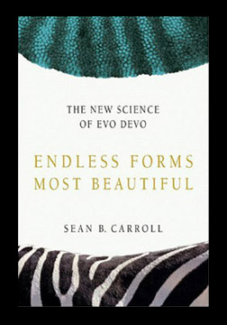
From Genotype to Phenotype: Evo-Devo
“Because human evolution is largely a matter of the evolution of the size, shape, and fine-scale anatomy of structures, and of timing in development…
I believe that the weight of genetic evidence is telling us that the evolution of primates, great apes, and humans is due to changes more in the control of genes than in the proteins the genes encode (Carroll 2005: p.270).”

Slide 11
Levels of Selection:
At which level does selection act?
Gene
Somatic cell lineage
Individual organism
Group
Species

Slide 12
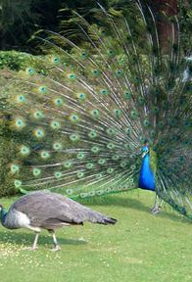
Sexual Selection (yet another type of selection)
Refers to competition within or between the sexes over mating
Darwin emphasized male-male competition and female choice
Consequences: many sexual dimorphisms, reproductive benefits at expense to longevity

Slide 13
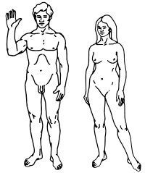
Sexual Selection
In the event extraterrestrial life forms ever encounter the Pioneer spacecraft, here’s what they’d see of human dimorphisms depicted on it:

Slide 14
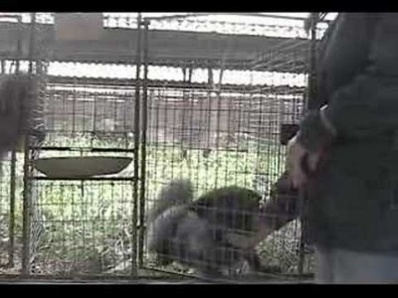
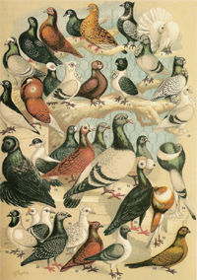
Artificial Selection
Humans can serve as the selective agents operating on other species

Slide 15

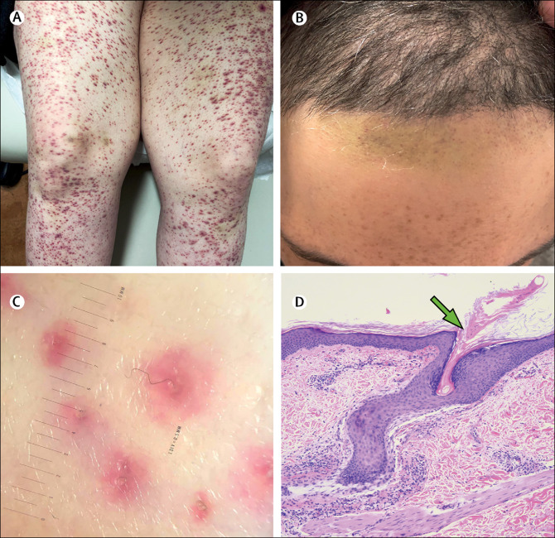
Constraints on Adaptationism
Is every trait an adaptation?
No—there are various constraints on adaptations arising.
  Mismatches between the environment in which a trait evolved and where it’s expressed today
  Example: Humans, vitamin C, and scurvy

Slide 16
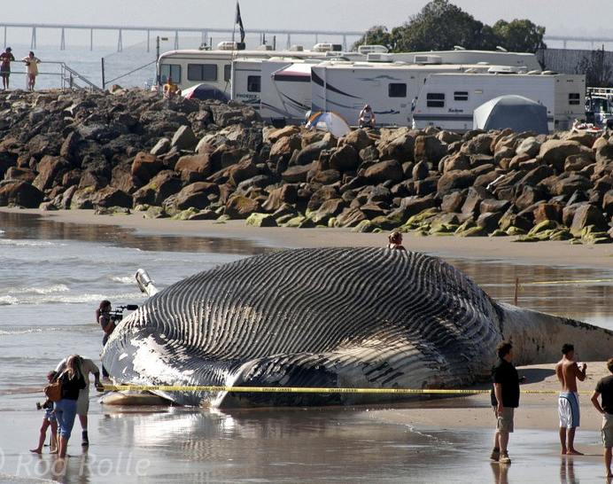
Constraints on Adaptationism
Physical and other constraints (e.g. oxygen, gravity)
Largest insects lived long ago in more oxygen-rich atmosphere (3 foot-long dragonflies!); larger-boned marine creatures (e.g., female gray whales) thanks to water’s buoyancy.

Slide 17
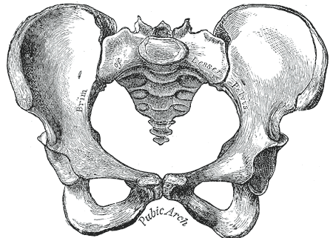
Constraints on Adaptationism
Tradeoffs
Human female pelvis: designed for walking vs. giving birth

Slide 18
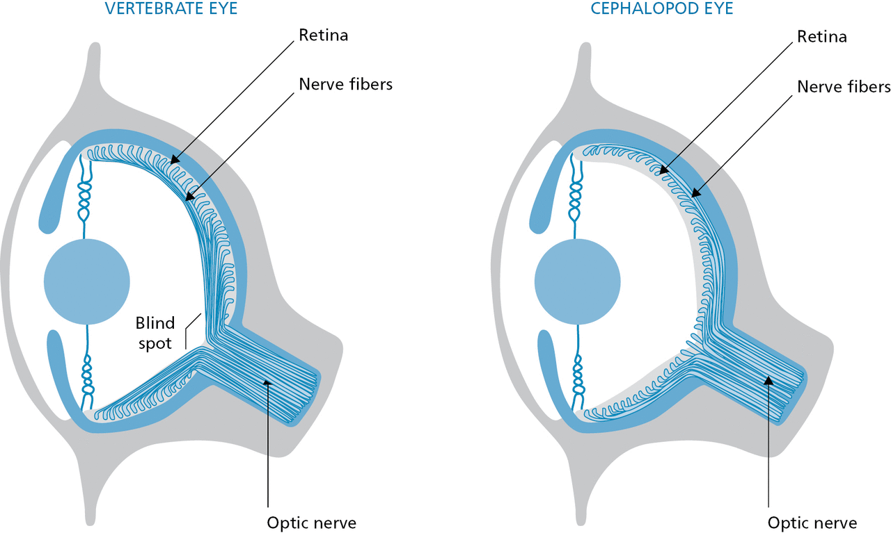
Constraints on Adaptationism
  Historical contingency
  Example: the human eye and ‘blind spot’; see p. 27 of the textbook for details.
Notes:
(evolution doesn’t design a body from scratch, but by tinkering with available & existing raw materials)

Slide 19
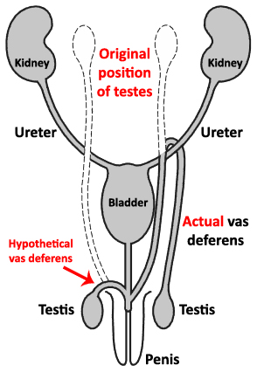
Vas deferens
The winding path of contingency:

Slide 20
Constraints on Adaptationism
  Available genetic variation
  Genetic variation ultimately traces back to mutations (e.g., point mutations, gene duplications), but one can’t “will” or predict whether a desirable mutation will arise

Slide 21
Other Processes of Evolution
Besides selection, there are three other forces capable of changing “gene frequencies in a population over time” (one definition of evolution)
  Mutation
  Gene flow
  Genetic drift
Notes:
Gene flow - Exchange of genes between populations, either by matings or by migrations
Humans have been mobile over our species’ evolutionary history and transportation technologies have facilitated gene flow
Genetic drift - Random change in allele frequencies due to the process of sampling alleles
Effects depend on population size
In relatively small, isolated populations, like may have occurred during much of human evolutionary history, genetic drift significantly contributes to evolution as it results in a greater proportion of change among the population compared to a larger, more mobile population.
Also has the effect of decreasing within-population variation, in turn affecting fixation of alleles

Slide 22
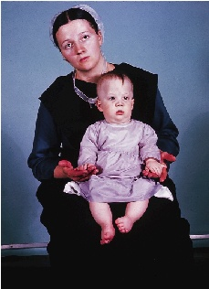
Examples of Gene Flow (and a subset: Founder Effect)
Polydactyly among Amish
  More than 5 fingers/toes on each hand/foot
Eastern Finnish population may be descended from 20-30 families, and have higher prevalence of some diseases compared with the larger surrounding population

Slide 23

Does evolution have a direction?
Teleology: believing that if some feature of an organism performs a function then it has been chosen to achieve some goal or purpose.
Every feature is not an adaptation.

